Slide 1

Circulatory Vital Signs
Alex Mariakakis
University of Toronto
Department of Computer Science

Slide 2
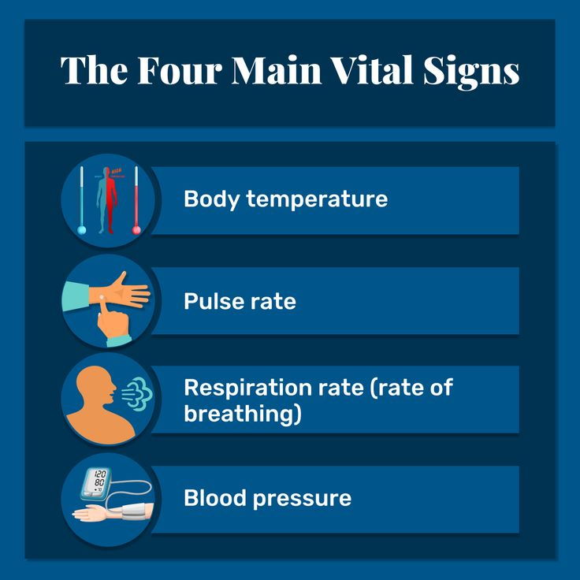
What Are Vital Signs?
Vital signs are measurements of physiological functioning that indicate the overall health status of a person
There are four “main” vital signs, but some have suggested extending the list:
5th: Pain
6th: Gait speed

Slide 3
How Can We Measure Heart Rate?
Signal Name | Traditional Sensors | Target Phenomenon
Phonocardiography (PCG) | Stethoscopes, microphones | Sounds produced by the opening and closing of the aortic valve
Electrocardiography (ECG) | Electrodes | Electrical signals in the heart
Ballistocardiography (BCG) | Motion sensors | Repetitive motions caused by the ejection of blood from the heart
Photoplethysmography (PPG) | Light source and optical sensors | Optically detectable blood volume changes in a region of tissue

Slide 4
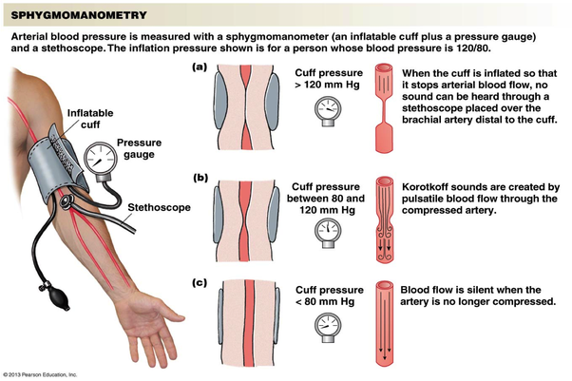
How Can We Measure Blood Pressure?

Slide 5
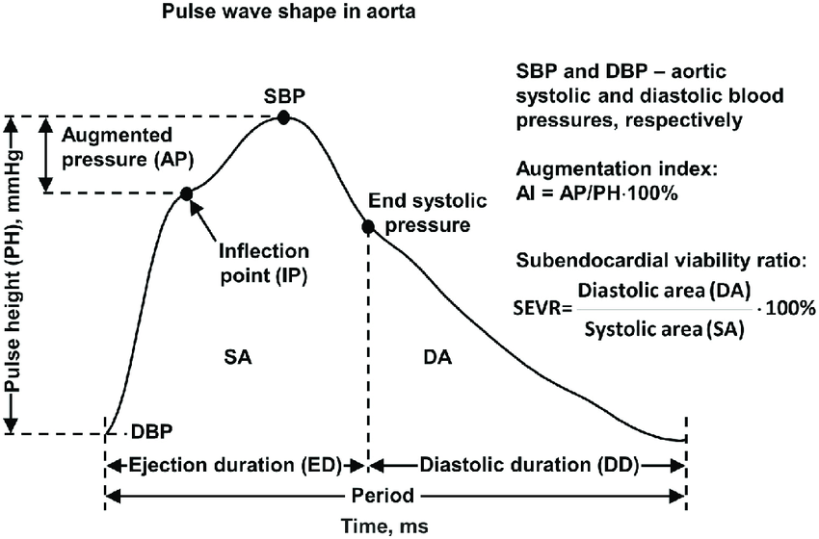
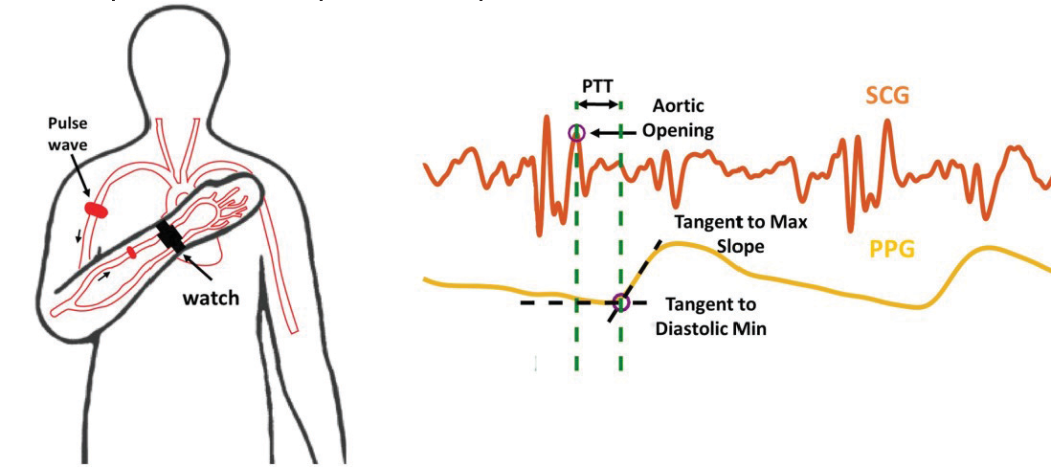
How Can We Measure Blood Pressure?
Pulse Transit Time (PTT)
Pulse Wave Analysis (PWA)
Measures the time it takes for a pulse to go from one part of the body to another
Examines the shape of a single pulse to infer blood pressure
Both approaches rely on proxies that are subject to many confounds (e.g., height, arterial stiffness, etc.)

Slide 6
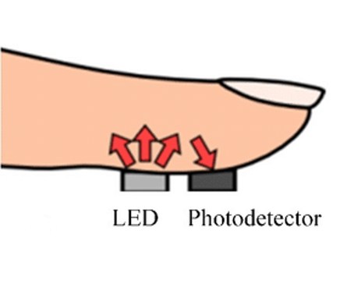
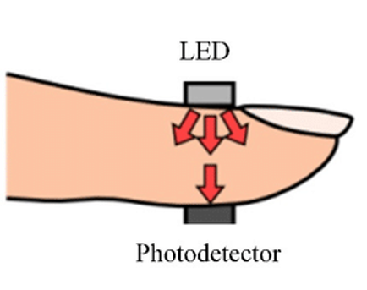
PPG In More Detail
Reflective
There are two possible PPG sensor configurations:
Reflective: Light source and sensor are on the same side; light is shone into the fingertip and reflected back into the sensor
Transmissive: Light source and sensor on opposite sides; light is shone into the fingertip and gets received on the other side
PPG is most often used on extremities like wrists and fingers, but similar principles apply to facial PPG at a distance
Transmissive

Slide 7
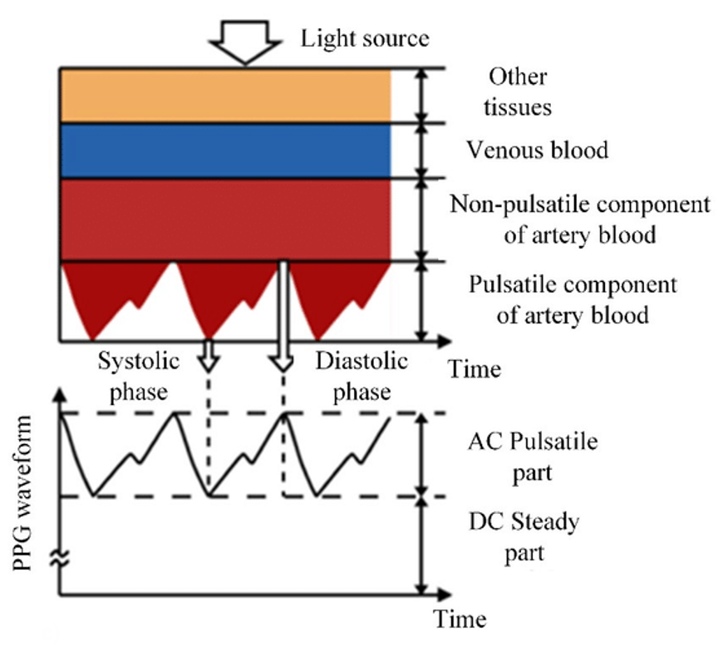
PPG In More Detail
Observed signal depends on:
Skin tone (constant)
Venous blood (constant)
Artery blood (constant + pulsatile)
Shape features should only depend on the pulsatile component of the signal, but factors like skin tone will influence signal quality
Comparing constant and pulsatile components across multiple wavelengths can also provide information on the blood’s contents (e.g., hemoglobin, oxygen content)

Slide 8
Resources
Photoplethysmography and Its Application in Clinical Physiological Measurement (Allen ‘07)
Advances In Non-Invasive Blood Pressure Measurement Techniques (Panula et al. ’22)

